Slide 1

Traffic Light
Group 1

Slide 2
About us and our proffesor
This project is made by group 1 :
Wael Habib Alkiyani – 2137465
Ali Zaid Hamidaddin – 2137162
Khaled Salem Jaber Ahmed – 2244524
Abdulaziz Bander Alharthy – 2237558
This project is made for Proffesor MD Abdul Hamid

Slide 3
Abstract
Why did we choose this particular project ?
We aimed in applying our theoratical knowledge into making something that we see on a daily basis .
We wanted to work something that will teach us how to contibute in our society and for our country
We choose the basis understanding of circuits and clock pluses to achieve the results .

Slide 4
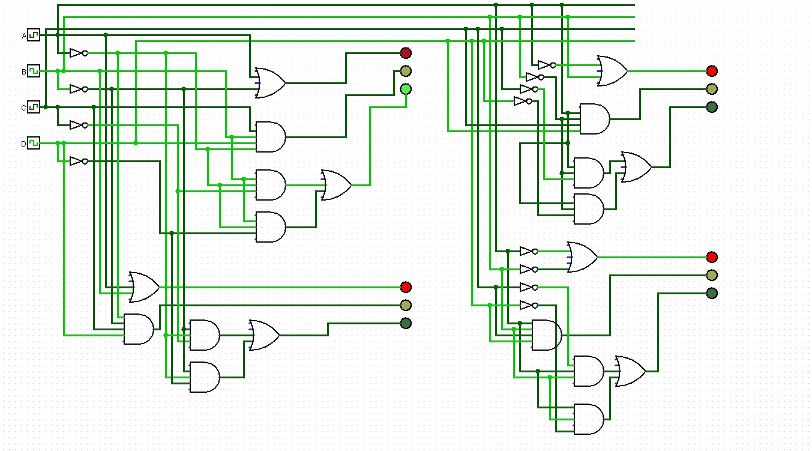
Simulation screenshot

Slide 5
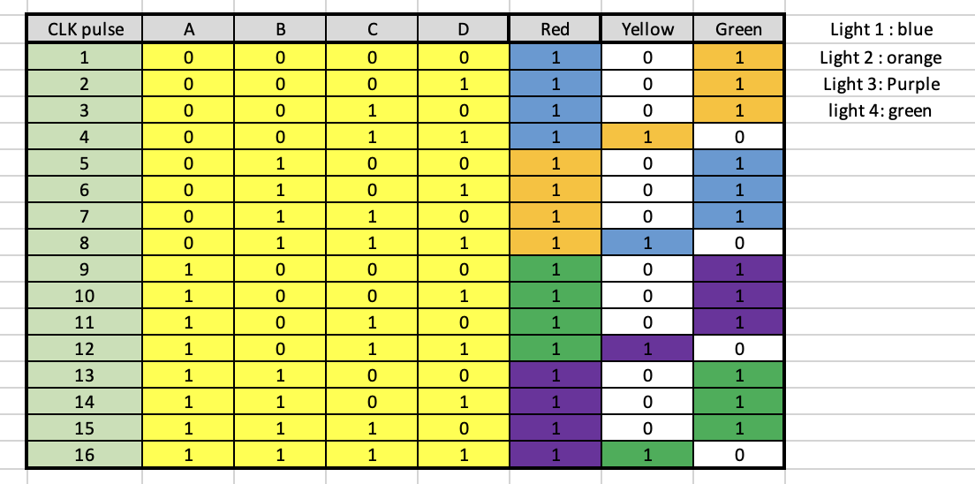
Combined astheic Truth table

Slide 6
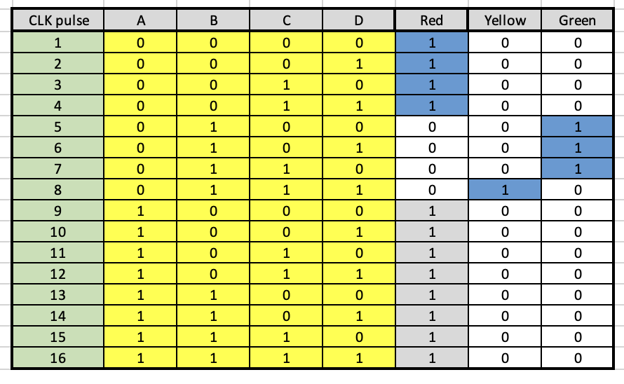
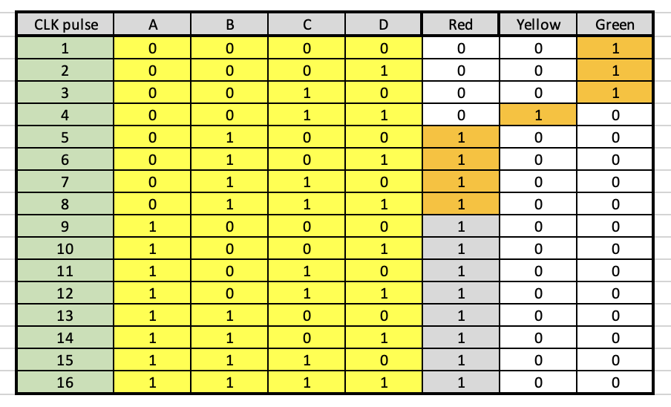
Truth table

Slide 7
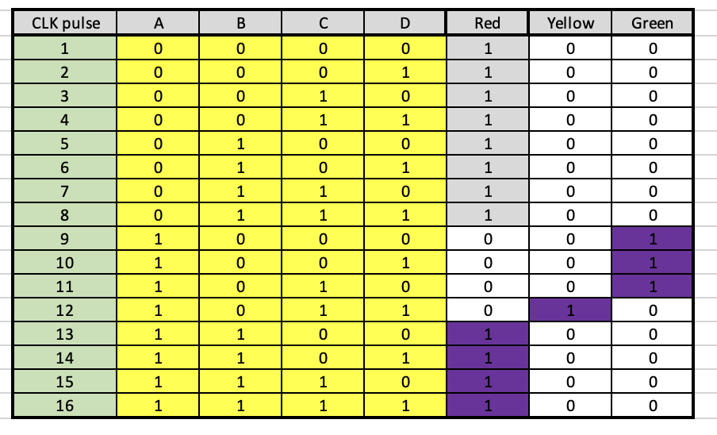
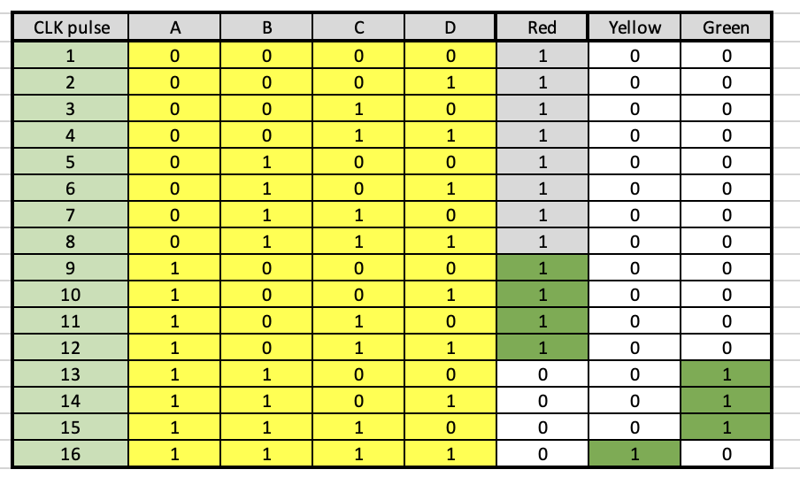
Truth table

Slide 8
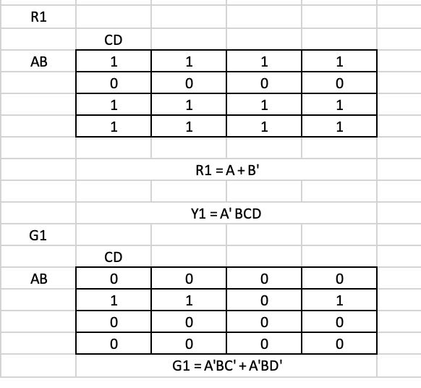
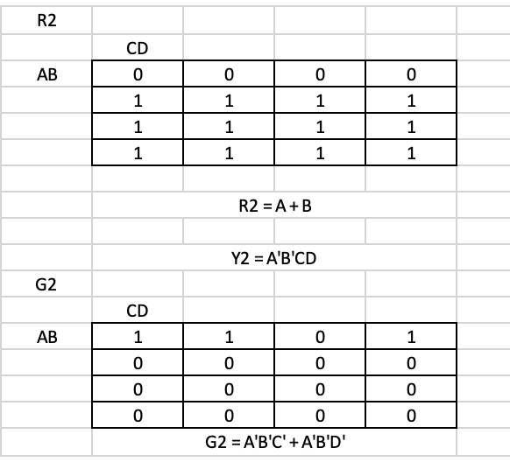
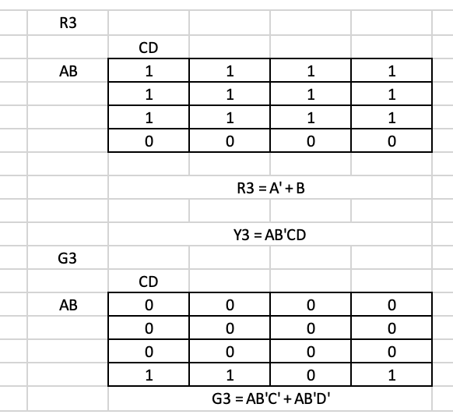
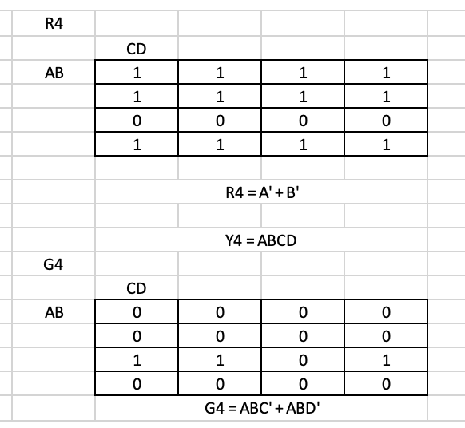
How did we drive the circuit ?

Slide 9
Once again Simulation screenshot

